Slide 1

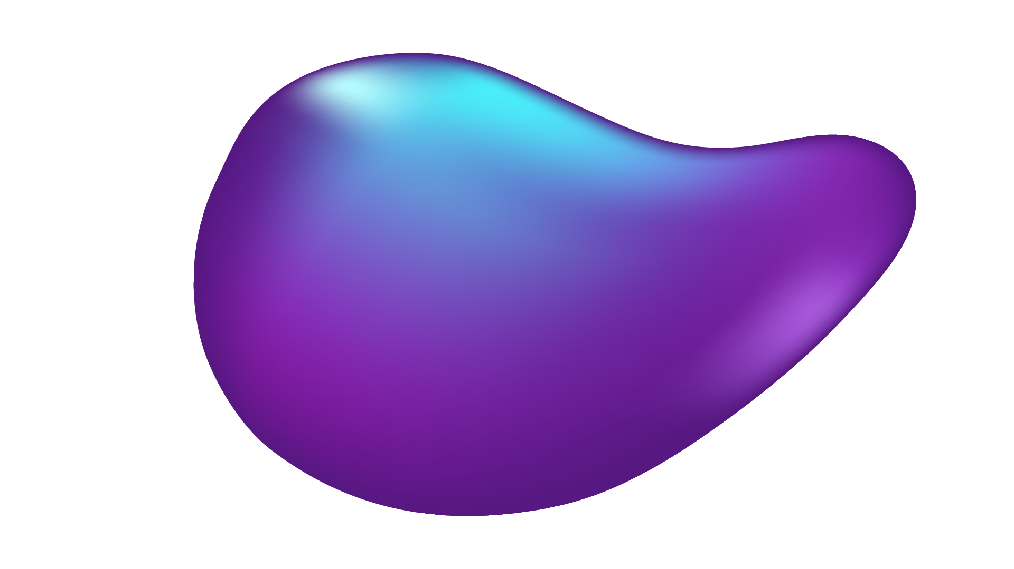
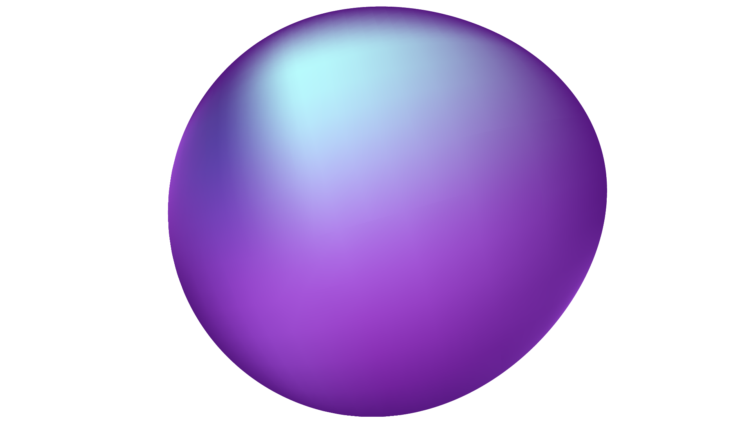
Neural Networks: Deep Learning
Usage of different classification methods on the CIFAR-10 dataset
Kakandris Iasonas
AEM: 10003
kiasonas@ece.auth.gr

Slide 2
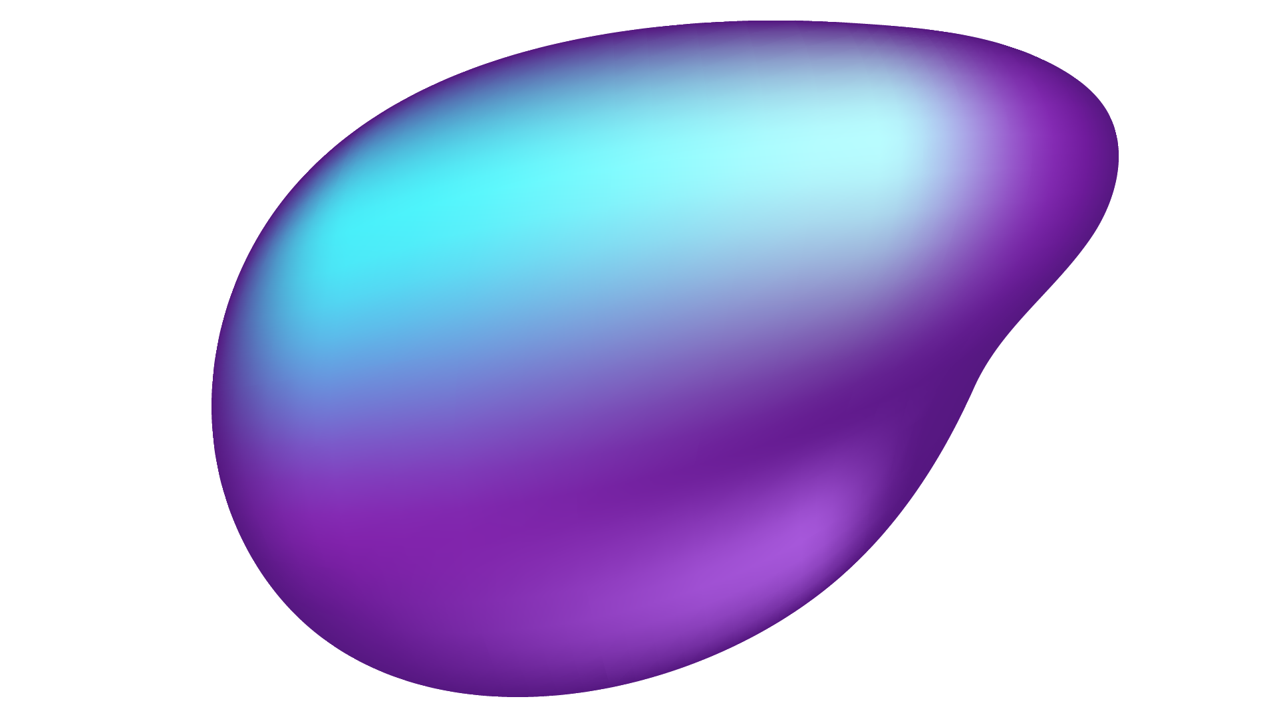
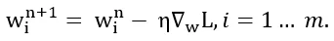
Multilayer perceptron
Activation functions
ReLU
Softmax
Optimizer
Stochastic Gradient Descent
Adam
Loss
Categorical Cross entropy
Activation Softmax Loss Categorical Cross Entropy
Layer_Dense
Forward pass
Back propagation
Accuracy
Accuracy_Categorical class

Slide 3
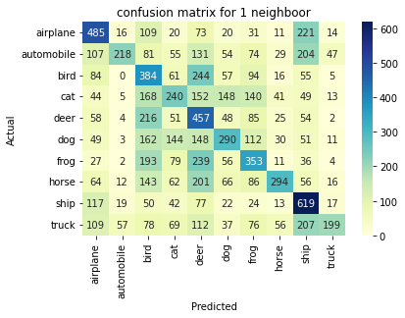
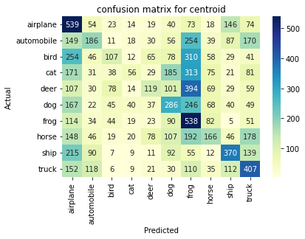
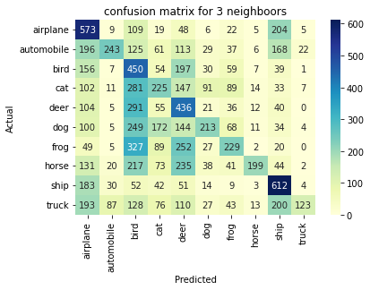
Results
1 Nearest Neighbour: acc= 35.39% time= 34.5s
3 Nearest Neighbours: acc= 33% time= 41.5s
Nearest Centroid algorithm: acc= 27.7%
Notes:
Cross Validation Cross-validation scores with 1nn:
0.3382 0.3406 0.3464 0.3382 0.3454 0.36 0.3424 0.3404 0.352 0.3496
The cross-validation report 3nn
0.3308 0.327 0.3326 0.3236 0.3306 0.3402 0.3294 0.3258 0.326 0.331
Cross validation centroid
0.2696 0.2768 0.2656 0.256 0.2858 0.2708 0.26 0.2704 0.2672 0.2724

Slide 4
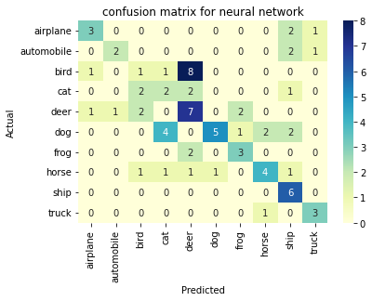
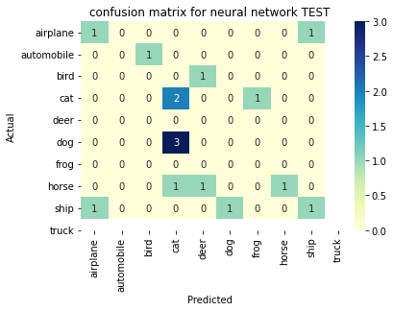
Results of MLP
We used
batches for training
3 layers and 128 neurons
learning_rate=2.5, decay=5e-5
SGD: acc= 10% loss= 2.305 time= 92.8s
SGD with momentum: acc= 10% loss=2.309 time= 200.3s
Adam: acc= 48% loss= 1.464 time= 168.06S
10th epoch
BEST RESULT
Best accuracy & loss :
3 Layers 256 neurons adam
acc= 49% loss= 1.357 time= 412.73s
Notes:
2 Layers 128 neurons
Elapsed time: 289.39s
Epoch Training Acc Training Loss Validation Acc Validation Loss Learning Rate
10 0.489 1.428 0.482 1.465 0.0008365050817683717
2 Layers 256 neurons
Elapsed time: 463.74s
10 0.496 1.432 0.471 1.479 0.0008365050817683717
3 Layers 256 neurons
Elapsed time: 412.73
3 0.516 1.357 0.490 1.447 0.0008365050817683717
4 layers 128 neurons
Elapsed time: 283.95s
3 0.489 1.428 0.482 1.465 0.0008365050817683717

Slide 5
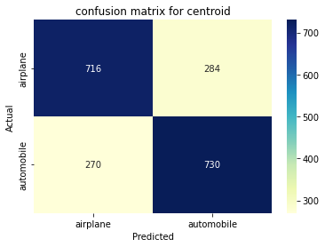
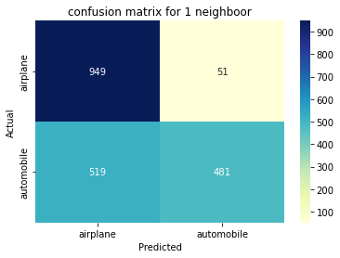
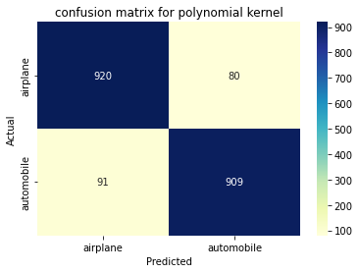
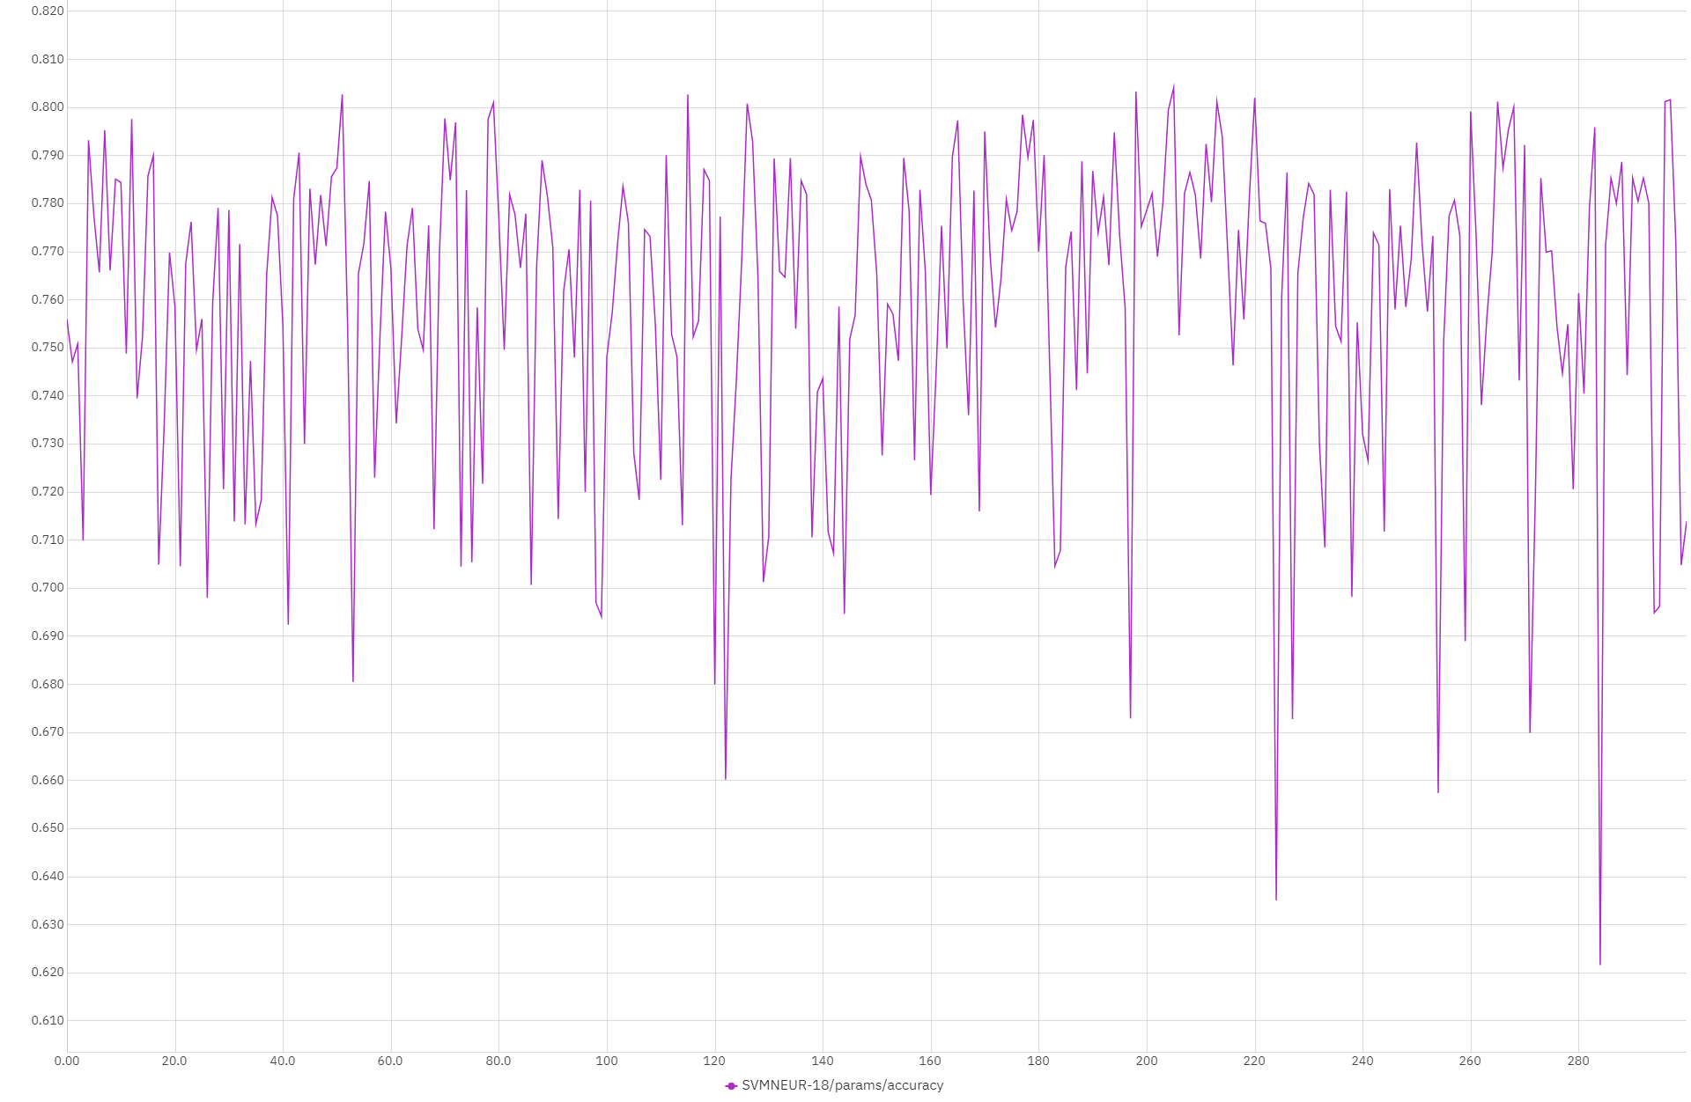
Support Vector Machines
2 classes classification best results
1 Nearest Neighbor: 72% 0.044s
3 Nearest Neighbors: 69% 0.046s
Nearest Class Centroid : 72% 0.134s
Polynomial kernel: 91% 76.44s
Linear kernel: 80% 199.87s
Rbf kernel 90% 77.82s
Sigmoid kernel 69% 62.09s
SVM from scratch
300iters lr:0.001 lambda: 0.01
83% 52.6s
Notes:
60 iters are enough for the svm from scratch

Slide 6
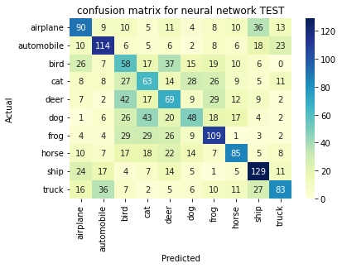
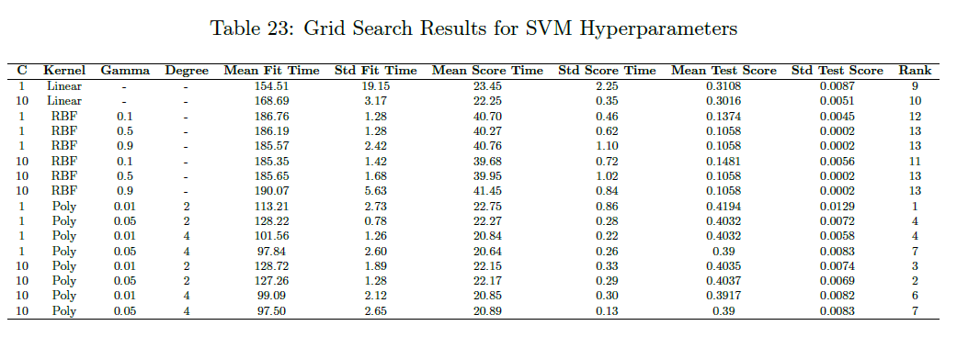
multiple batched size classification
1 Nearest Neighbor: 28% 0.044s
3 Nearest Neighbors: 27% 0.05s
Nearest Class Centroid : 28% 0.17s
Polynomial kernel: 42% 203.72s

Slide 7
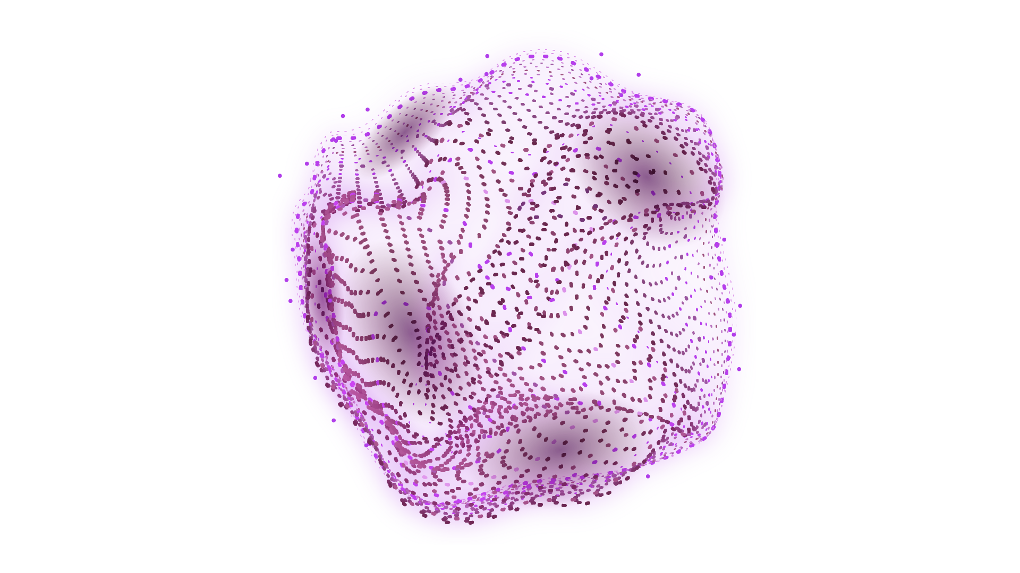
RBF Neural Network
Centers Initializer
Random centers
K means centers
K means centers per class
Neural Networks
RBF Neural Network
RBF Neural Network torch
Best Results
RBF Neural Network
Centers = 1000
Sigma = 8
Random centers
RBF Neural Network torch
Centers = 500
Sigma = 2
K means per class
lr=0.008, epochs=150
optimizer='adam'
weight_decay = 1e-6
Despite being red, Mars is actually a cold place. It’s full of iron oxide dust
46.86% accuracy
Elapsed time 89.44s
45.29% Accuracy
1.5321 Loss
Elapsed time 290.37s
Notes:
RBFNeuralNetwork Class
4.1.1 Random center initializing
n_centers=500, rbf_width=10.0 Training Accuracy: 46.10% Test Accuracy: 45.53% Elapsed time 152.99s
n_centers=500, rbf_width=0.5 Training Accuracy: 10.92% Test Accuracy: 10.00% Elapsed time 52.28s
n_centers=500, rbf_width=5 Training Accuracy: 37.34% Test Accuracy: 37.01% Elapsed time 76.32s
n_centers=100, rbf_width=5 Training Accuracy: 31.55% Test Accuracy: 31.81% Elapsed time 22.66s
n_centers=100, rbf_width=10 Training Accuracy: 40.08% Test Accuracy: 39.96% Elapsed time 39.26s
n_centers=1000, rbf_width=10 Training Accuracy: 47.81% Test Accuracy: 46.92% Elapsed time 313.51s (without pca)
4.1.2 K-means initializer
n_centers=500, rbf_width=10 Training Accuracy: 44.11% Test Accuracy: 43.63% Elapsed time 3431.12s (without pca)
n_centers=100, rbf_width=10 Training Accuracy: 39.47% Test Accuracy: 39.61% Elapsed time 1637s (without pca)
n_centers=10, rbf_width=10 Training Accuracy: 29.30% Test Accuracy: 30.30% Elapsed time 208.29s (without pca)
RBFNeuralNetwork Torch Class
n_centers=500, rbf_width=2 Accuracy: 44.18% Elapsed time: 219.74s (with pca)
K-means initializer
lr=0.01 , weight_decay = 1e-6 Accuracy test: 42.98% Elapsed time: 454.57s (with pca)
K-means initializer per class
lr=0.01,weight_decay = 1e-6 Accuracy for test data 44.44% Elapsed time: 303.76s (with pca)
lr=0.008 weight 1e-6 These parameters had the best results. The accuracy was 45.29% and the loss from the training data 1.5321.

Slide 8
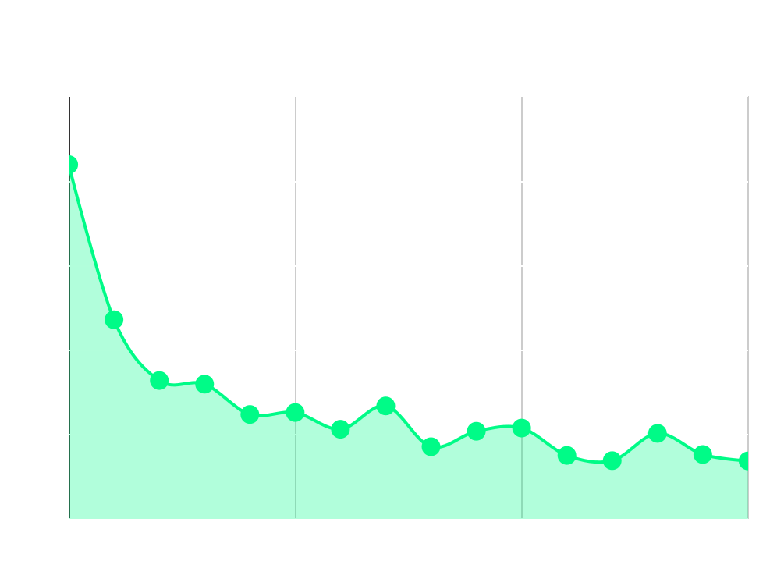
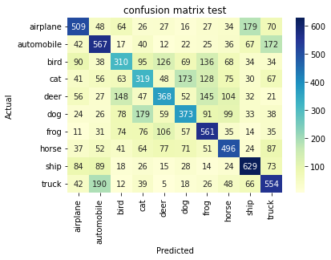
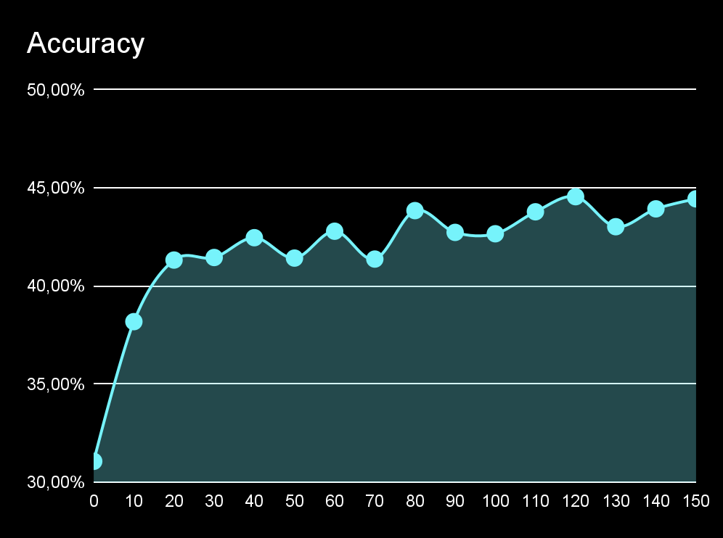
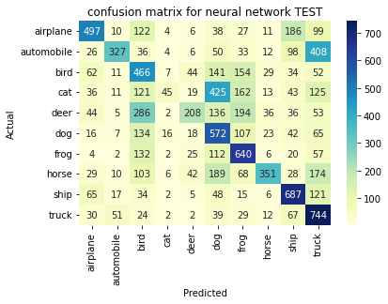
Model training and Results
RBF Neural Network torch
RBF Neural Network
RBF Neural Network torch

Slide 9
Conclusion
Best result : Multilayer perceptron with 3 layers 128 neurons. Acc 48% loss 1.464 time 168s which could be reduced using PCA
The method that would be benefited the most from using PCA would be SVM with polynomial kernel. Batched data (10% of original) elapsed time 203.72s
Best accuracy and loss: MLP with 3 Layers 256 neurons adam Acc 49% loss 1.357 time 412.73s. It could benefit from PCA
Fastest method with good accuracy (with PCA) RBF Neural Network random centers: Centers 1000 Sigma 8 Acc 46.86% time 89.44s
Notes:
1 Nearest Neighbour: acc= 35.39% time= 34.5s
3 Nearest Neighbours: acc= 33% time= 41.5s
Nearest Centroid algorithm: acc= 27.7%
Adam: acc= 48% loss= 1.464 time= 168.06S
Polynomial kernel: 42% 203.72s (BATCHED : we should use PCA)
RBF Neural Network 46.86% accuracy Elapsed time 89.44s (pca)
RBF Neural Network torch 45.29% Accuracy 1.5321 Loss Elapsed time 290.37s

Slide 10

THANKS!
DO YOU HAVE ANY QUESTIONS?
Iasonas kakandris
kiasonas@ece.auth.gr
AEM: 10003

